Slide 1
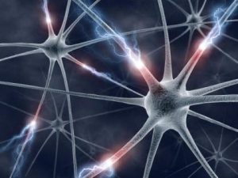
Is intelligence a fixed point, or can it change? Think and then discuss.

Slide 2
Please put the date and title in your book and underline with a ruler.
C/W
Date Month Year
How Can Growth Mindset Help Me?

Slide 3
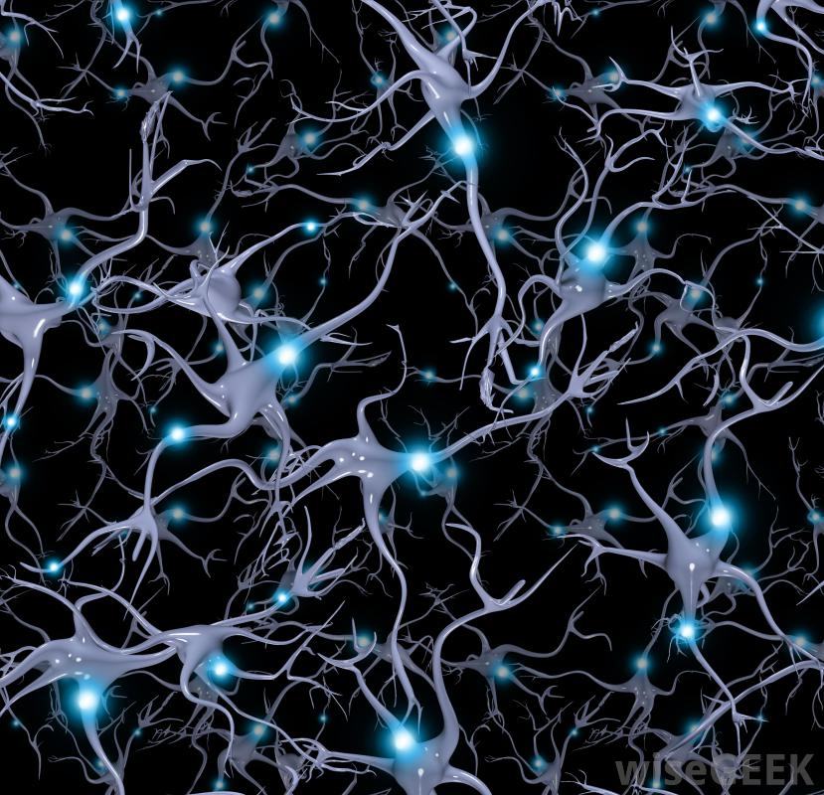
How We Learn – Synapses and Neural Pathways
In the nervous system, a synapse is a structure that permits a neuron (or nerve cell) to pass an electrical or chemical signal to another neuron.
Notes:
https://www.youtube.com/watch?v=t4np5wLAhWw

Slide 4
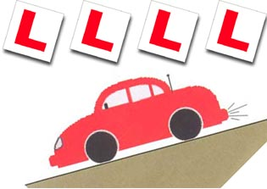
Can you drive?

Slide 5
What will you do to ensure you can drive by the time you are 20?
Notes:
Discussion about learning, being shown what to do, and practising.

Slide 6
What advice would you give to someone who failed their driving test the first time they took it?
Notes:
Discussion about learning, being shown what to do, and practising.

Slide 7
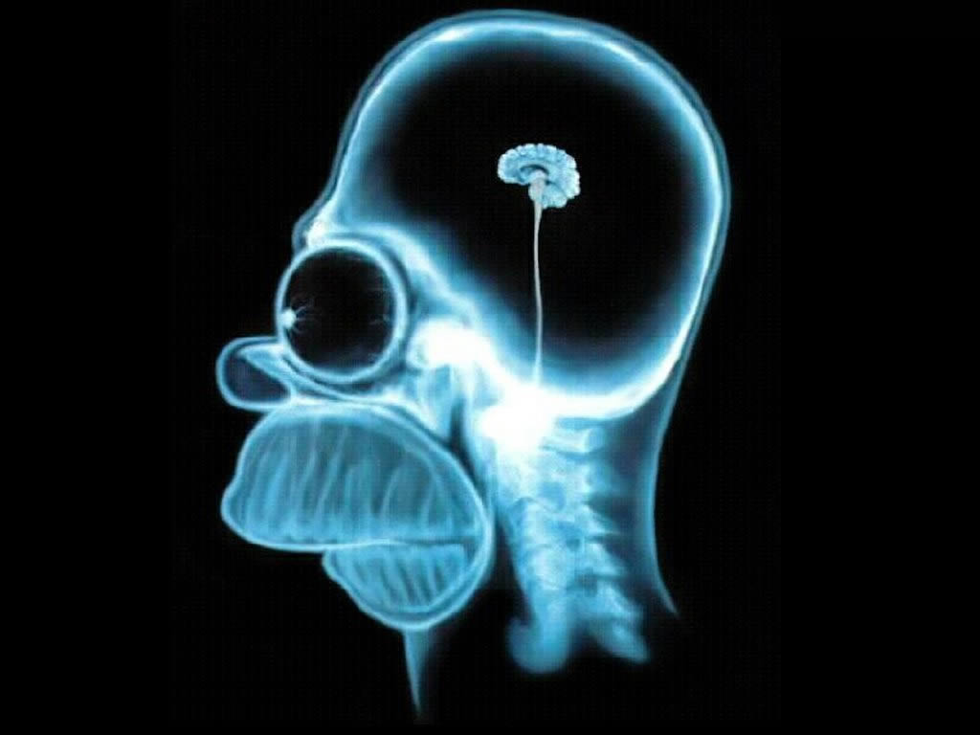
Are you clever?
Notes:
Ask students to talk about this question.
Then watch this short clip: https://www.youtube.com/watch?v=ElVUqv0v1EE

Slide 8
Are you clever?
What do you think of this question?
Notes:
Ask students to talk about this question.
Then watch this short clip: https://www.youtube.com/watch?v=ElVUqv0v1EE

Slide 9
Can I get smarter?
Notes:
Discuss about growing your brain and learning, making new and stronger connections in the brain.

Slide 10
Individual Task
3) Explain what happens inside the cortex of the brain when you learn new things.
2) Explain what the phrase ‘use it or lose it’ means with regard to weightlifting. How can it link to the brain?
1) What advice would you give to a friend who said they found one particular subject at school really hard?
Notes:
Read page 1 of the article ‘You Can Grow Your Intelligence’.
Article can be found at https://www.mindsetworks.com/websitemedia/youcangrowyourintelligence.pdf

Slide 11
Now answer this question in your book.
How Can Growth Mindset Help Me?
Set yourself 3 specific goals that will help you to improve your learning.
E.g. Read for 20 mins per day, and different types of texts (e.g. science magazine, web journal). Set a specific reading time per day.
Keep a journal or blog to practise writing skills: set a specific time to spend on this each day / week.

Slide 12
Now answer this question in your book.
How Can Growth Mindset Help Me?

